Slide 1
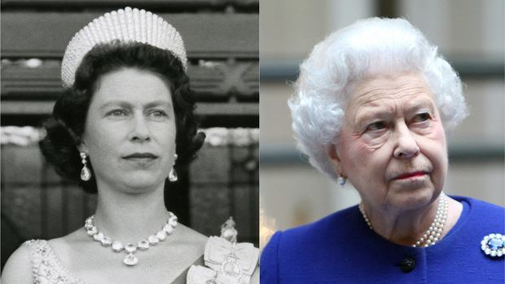
The longest - lived Monarch in the world
Queen Elizabeth II:
April 21, 1926-September 8, 2022

Slide 2
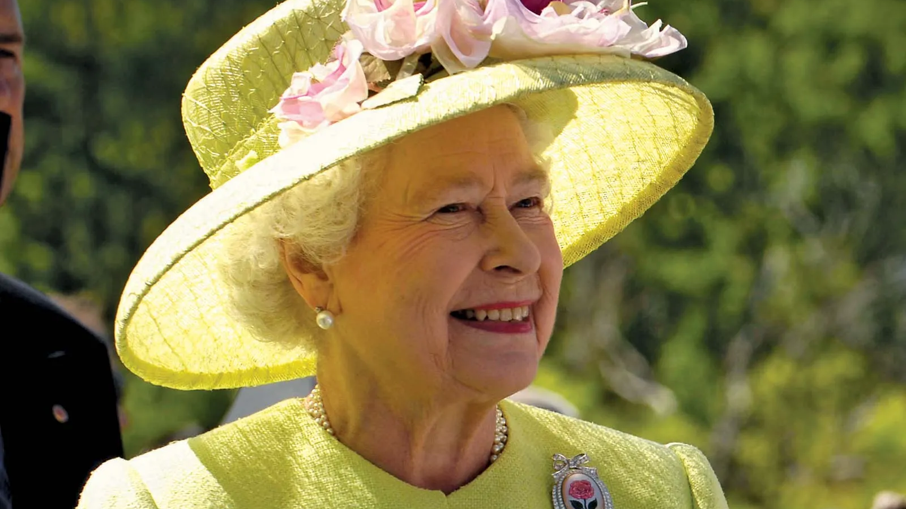
Elizabeth II (Elizabeth Alexandra Mary) was the Queen of the United Kingdom and other Commonwealth realms from 6 February 1952 until her death in 2022. She was queen regnant of 32 sovereign states during her lifetime and 15 at the time of her death. Her reign of 70 years and 214 days is the longest of any British monarch, the longest recorded of any female head of state in history, and the second-longest verified reign of any sovereign in history.

Slide 3
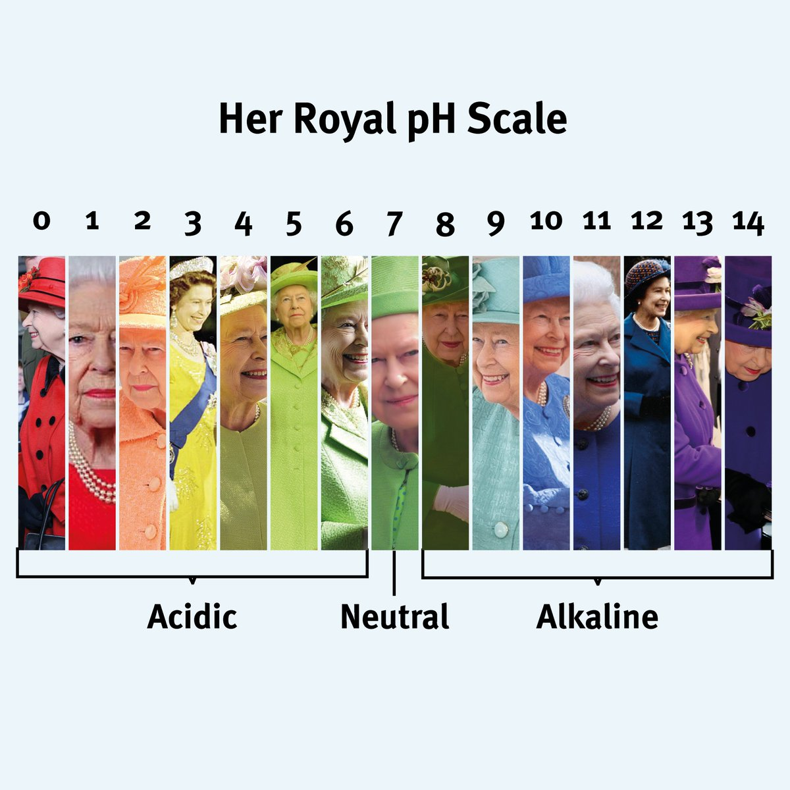
The Queens pH scale
The Queen liked going out in different apparel colors.
The reason why she did so was because as she had said "I need to stand out for people to be able to say 'I saw the Queen'" and "I can never wear beige because nobody will know who I am".

Slide 4
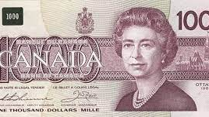
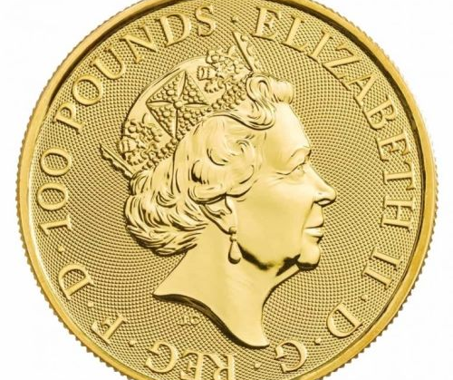
In the countries dependent on Great Britain there are coins and banknotes with the image of the queen, these are countries such as:
Dependent territories of Great Britain: Gibraltar, Cayman Islands, Falkland Islands, Man, St. Helena,
Great Britain - England and the Channel Islands (Jersey, Guernsey),
Australia,
Canada,
New Zealand,
Bermuda (in the Atlantic Ocean),
Bahamas (Central America),
Belize (former British Honduras, Central America),
Eastern Caribbean countries sharing a common currency, such as Antigua and Barbuda, Dominica, Granada, Saint Lucia, Saint Vincent and the Grenadines.

Slide 5
"Queen Elizabeth II was born in 1926… making her officially older than sliced bread"
That's right, the Queen was born before we had invented sliced bread, something we all take for granted nowadays.
She is allso older than FM Radio(1940), handheld calculators (1965) and ballpoint pens(1945)

Slide 6
Fun facts:
The queen's personal fortune is estimated at around £ 340 million, and an interesting fact is that she is not even on the list of the top 300 richest Britons.
The Queen has completed over 250 trips abroad, visiting 115 countries, including Poland in 1996.
Queen Elizabeth never went to school. She and her sister were taught by private teachers at home.
The character of Queen Elizabeth II has been copied in over 100 films and series.
Queen Elizabeth II was the legal owner of 1/6 of all lands on Earth.

Slide 7
The role of her majesty
Head of state
Head of the armed forces
Head of the commonwealth
Head of nation
Head of the Church of England
Patron of Charities
Constitutional Responsibilities

Slide 8
"God save the Queen"
The Queen had a national anthem made for her.
Since the queen is no longer with us parts of the anthem will change.
All parts of the anthem including the word "Queen" will change into "King"
For example "God save the Queen" will be "God save the King" because King Charles III is now in charge.

Slide 9
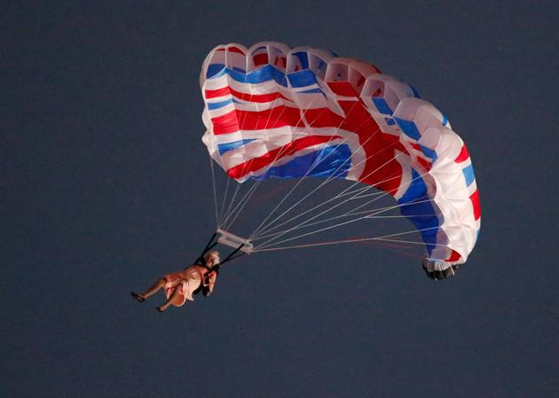
The Queen's humor.
President Bush once misspoke about the Queen adding 200 years to her age.
At a dinner hosted 2 days later the queen started "When I was here in 1776 …" Bush responded "Your Majesty I can't top that one myself"
The Queen once participated in a scene with "James Bond" in which she jumped out of a helicopter using a parachute.

Slide 10
Elizabeth II during WWII
During World War II, Elizabeth participated in radio programs in which she tried to improve the mood of other children. She also gave charity, and at the age of 18 she joined the Women's Auxiliary Territorial Service, where she learned the profession of a driver and mechanic.

Slide 11
The Coronation of Elizabeth II
The coronation ceremony of Queen Elizabeth II of the Windsor Dynasty was held on June 2, 1953 at Westminster Abbey in London. Elizabeth II ascended the throne at the age of 25 after the death of her father, George VI (February 6, 1952), and was proclaimed queen shortly thereafter. The coronation took place more than a year later due to the tradition that after the death of the monarch, sufficient time must pass before such ceremonies are held.

Slide 12
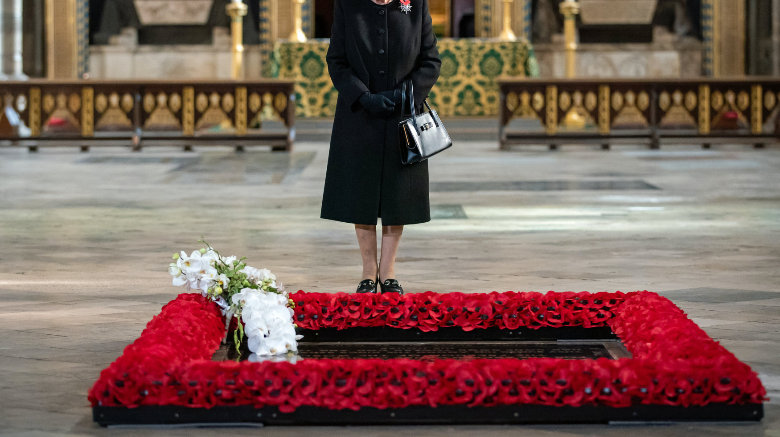
God Save the Queen, may she rest in peace

